Slide 1
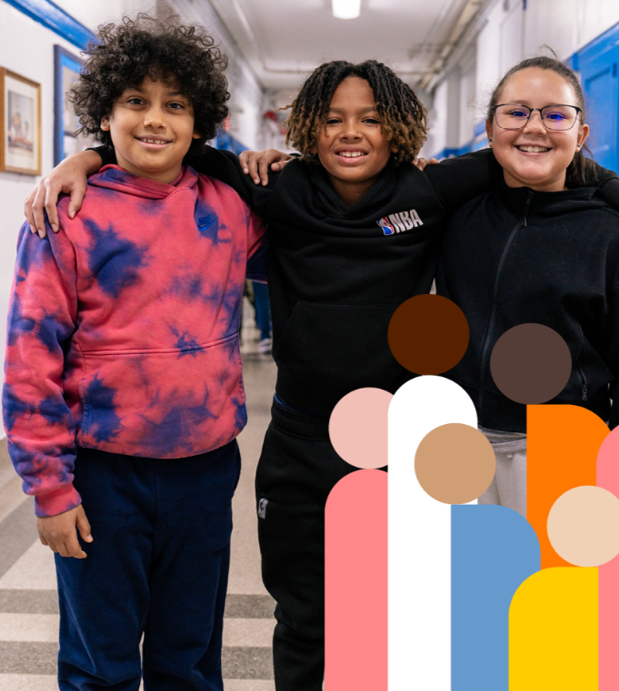

Respect for All: Parents as Partners
Office of Safety and Youth Development
Notes:
The term “parent,” whenever used in this presentation, means the student’s parent(s) or guardian(s), or any person(s) in a parental or custodial relationship to the student, or the student, if the student is an emancipated minor or has reached 18 years of age.

Slide 2
Welcome & Introductions
“It is time for parents to teach young people early on that in diversity there is beauty and there is strength.”
― Maya Angelou
Notes:
Welcome and thank you for joining us today.

Slide 3

Respect for All
All students deserve a safe, supportive school environment free of bullying and bias-based behavior
Notes:
Respect for All is our system-wide response to bullying and harassment. We are committed to keeping our schools safe, supportive, and free from discrimination.

Slide 4

Agenda
Part I
We will cover what bullying is and signs of bullying
Part II
We will cover how to address bullying and the multiple ways to report it for assistance
Part III
We will cover cyberbullying and the shared responsibilities we have to address it and ways to seek help to remove offensive posts
Students, parents, and school staff all have a role in making schools safe and must work together to achieve this goal.
Notes:
We will be presenting in three parts. Part I will cover what bullying is and signs of bullying. In part II we will cover how to address bullying and the multiple ways to report it for assistance.
n our last part, part III, we will cover cyberbullying and the shared responsibilities we have to address it and ways to seek help to remove offensive posts. Thank you.

Slide 5

Part 1: What is BUllying
Notes:
We must remember that our students’ safety and privacy needs to be just as protected online, for example during online learning, as it is in a classroom.
To help prevent cyberbullying, schools reinforce rules, responsibilities, and expectations with your children, and we ask parents to work with us to do so as well.
We view you as partners in supporting our students. School staff should keep parents informed of their child’s behavior and engage parents as partners in addressing areas of concern.
*Note to the presenter- Outreach to parents can include, but is not limited to, a phone call, an in-person conference, and written communication.

Slide 6
Part I: What is Bullying
Bullying is Not Conflict
Signs a Child Is Being Bullied
Signs a Child is Bullying Others
Reasons why some children don't ask for help?
Notes:
Today’s presentation will cover three parts. Part I will cover what bullying is and the differences between bullying and conflict. We will also discuss in part I, signs of bullying and reasons why some children don’t ask for help.

Slide 7
Part I: What is Bullying
Bullying behavior always involves an imbalance of power (physical or social) or strength between the person doing the bullying and the target of the behavior.
The person doing the bullying may be physically bigger or stronger or may be older or have greater social status or social power than the person being targeted.
Harassment and/or bullying may take many forms and can be physical, non-verbal, verbal, or written.
It may be a single incident or a series of related incidents.
Bullying is behavior that is intended to cause some kind of harm.
The person doing the bullying purposely says or does something to hurt the target of their behavior.
Notes:
What is Bullying?
Bullying behavior always involves an imbalance of power (physical or social) or strength between the person doing the bullying and the target of the behavior.
The person doing the bullying may be physically bigger or stronger or may be older or have greater social status or social power than the person being targeted.
Harassment and/or bullying may take many forms and can be physical, non-verbal, verbal, or written.
It may be a single incident or a series of related incidents.

Slide 8
Power Imbalance
A power imbalance can reflect a perceived power imbalance that has nothing to do with physical size or strength
The perceived power imbalance can be based on popularity, academic achievement, English proficiency, socioeconomic factors, or anything else to which students might place importance.
Notes:
A power imbalance can reflect a perceived power imbalance that has nothing to do with physical size or strength. The perceived power imbalance can be based on popularity, academic achievement, English proficiency, socioeconomic factors, or anything else to which students might place importance.
The stereotype of the physically powerful student athlete stealing the lunch money of a physically smaller classmate does not come close to accurately depicting all possible bullying scenarios.

Slide 9
What are some examples of
banned behaviors?
Stalking
Hazing
Taunting
Physical Violence
Exclusion from peer groups designed to humiliate or isolate.
Verbal or physical conduct that threatens another with harm;
Seeking to coerce or compel a student or staff member to do something;
Written or graphic material, including graffiti, containing comments or stereotypes that are either posted or circulated on the Internet (cyberbullying);
Making derogatory statements or using language to humiliate or harass other students based on actual or perceived race, color, creed, ethnicity, national origin, citizenship/immigration status, religion, gender, gender identity, gender expression, sexual orientation, disability, or weight;
Notes:
What are some examples of banned behaviors? In addition to some of the examples you see other examples of banned bullying behaviors are written or graphic material, including graffiti, containing comments or stereotypes that are either posted or circulated on the Internet (cyberbullying).
Making derogatory statements or using language to humiliate or harass other students based on actual or perceived race, color, creed, ethnicity, national origin, citizenship/immigration status, religion, gender, gender identity, gender expression, sexual orientation, disability, or weight.

Slide 10
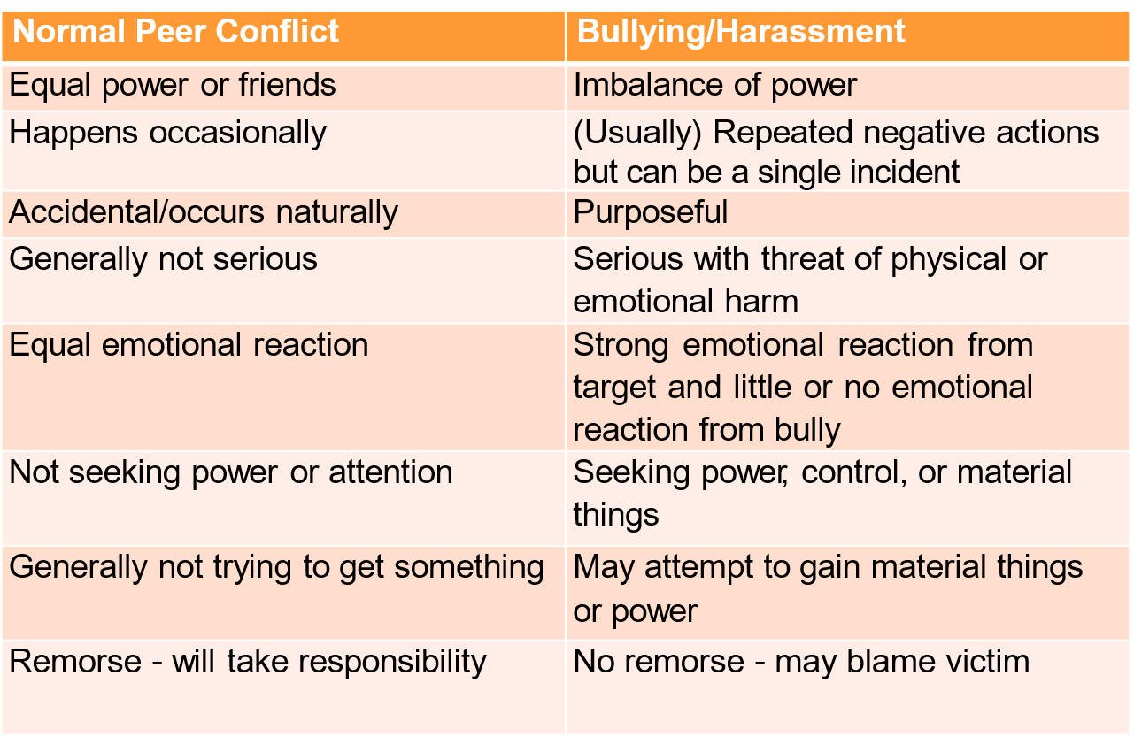
Bullying Is Not Conflict
Notes:
And thus, bullying is not conflict.
Conflict is a struggle between two or more people who perceive they have mismatched goals or desires. Conflict occurs naturally as we interact with one another. It is a normal part of life that we will not always agree with other people about the things we want, what we think, or what we want to do.
When one or both people have the skills to resolve the conflict, both sets of needs can be met, the same conflict between the same two people will most likely not be repeated.
Neither mediation nor conflict resolution is under any circumstances an appropriate intervention for bullying or intimidation.
Examples of impact on victims:
(e.g., the student is not regularly attending classes; the student’s academic performance or performance in class has changed); (e.g., the student is no longer regularly attending extracurricular activities or level of participation is changed); (e.g., the student’s behavior in school is impacted; the student is withdrawn or isolating themselves; the student appears to be anxious, depressed, or distracted); (e.g., the student and/or other students or staff have expressed concerns about the student’s safety).

Slide 11
Scenario # 1 – Is it Conflict or Bullying?
Two siblings share a bedroom. They do not agree on how their furniture should be arranged or what color to paint the walls. They seek help from their parents and end up with a compromise they both can live with.
Notes:
Two siblings share a bedroom. They do not agree on how their furniture should be arranged or what color to paint the walls. They seek help from their parents and end up with a compromise they both can live with. Yes, you guessed it right, as parents we can all agree this seems like Conflict.

Slide 12
Scenario # 2 – Is it Conflict or Bullying?
An 8th grade student often shows up late for
lunch then proceeds to push his way to the front
of the line. The other students are intimidated
and dare not say anything about it.
Notes:
An 8th grade student often shows up late for lunch then proceeds to push his way to the front of the line. The other students are intimidated and dare not say anything about it.
Because they are intimidated and there seems to be a perceived power imbalance we can agree this seems like bullying.

Slide 13
Scenario # 3 – Is it Conflict or Bullying?
A group of young people regularly call another
student names and hold her/him/them up for
ridicule in front of other students. The student is visibly upset but says nothing.
Notes:
A group of young people regularly call another student names and hold her/him/them up for ridicule in front of other students. The student is visibly upset but says nothing.
This seems like bullying, the behavior is intentional to hurt another student emotionally.

Slide 14
Scenario # 4 – Is it Conflict or Bullying?
A 5th grader verbally taunts younger students on
the bus and does not let them sit where they
want to.
Notes:
And finally , A 5th grader verbally taunts younger students on the bus and does not let them sit where they want to. This seems like bullying where the behavior is abusive, intentional, and a perceived power imbalance seems to exist.

Slide 15
Signs a Child Is Being Bullied
Unexplainable injuries;
Lost or destroyed clothing, books, electronics, or jewelry;
Frequent headaches or stomach aches, feeling sick or faking illness;
Changes in eating habits, like suddenly skipping meals or binge eating;
Children may come home from school hungry because they did not eat lunch;
Declining grades, loss of interest in schoolwork, or not wanting to go to school;
Sudden loss of friends or avoidance of social situations or;
Self-destructive behaviors such as running away from home, harming themselves, or talking about suicide;
Feelings of helplessness or decreased self esteem;
Difficulty sleeping or frequent nightmares.
Notes:
What are some signs a child is being bullied? In addition to the signs on the slide, other signs include but not limited to:
Changes in eating habits, like suddenly skipping meals or binge eating. Children may come home from school hungry because they did not eat lunch.
Declining grades, loss of interest in schoolwork, or not wanting to go to school
Sudden loss of friends or avoidance of social situations or,
Self-destructive behaviors such as running away from home, harming themselves, or talking about suicide

Slide 16
Signs a Child is Bullying Others
Gets into physical or verbal fights;
Gets sent to the principal’s office or to detention frequently;
Has unexplained extra money or new belongings;
Is competitive and worries about their reputation or popularity;
Has friends who bully others;
Is increasingly aggressive;
Blames others for their problems;
Doesn’t accept responsibility for their actions.
Notes:
Signs a Child is Bullying Others:
Gets sent to the principal’s office or to detention frequently
Has unexplained extra money or new belongings
Is competitive and worries about their reputation or popularity

Slide 17
What are reasons why some children don't ask for help?
Bullying can be a humiliating experience. Children may not want adults to know what is being said about them, whether true or false. They may also fear that adults will judge them or punish them for "being weak".
Students who are bullied may already feel socially isolated.
Children may fear being rejected by their peers. Friends can help protect them from bullying, and children can fear losing this support.
Children may fear backlash from the kid who bullied them.
Bullying can make a child feel helpless. Children may want to handle it on their own to feel in control again. They may fear being seen as weak or a tattletale
They may feel like no one cares or could understand. And that’s why it’s important to keep communication lines open with your children and to let them know it’s okay for them to come to you with any concerns they have and not to be afraid to ask for help.
Notes:
What are reasons why some children don't ask for help? Tough question.
Bullying can make a child feel helpless. Children may want to handle it on their own to feel in control again. They may fear being seen as weak or a tattletale.
And they can always talk with their school counselor or any teacher and ask for help.

Slide 18
Part II:
Addressing Bullying and Asking for Help
Notes:
In part II of our presentation, we will discuss how to address bullying and how to report and ask for help from the superintendent’s office.

Slide 19
What are reasons why some children don't ask for help?
Bullying can be a humiliating experience. Children may not want adults to know what is being said about them, whether true or false. They may also fear that adults will judge them or punish them for "being weak".
Students who are bullied may already feel socially isolated.
Children may fear being rejected by their peers. Friends can help protect them from bullying, and children can fear losing this support.
Children may fear backlash from the kid who bullied them.
Bullying can make a child feel helpless. Children may want to handle it on their own to feel in control again. They may fear being seen as weak or a tattletale
They may feel like no one cares or could understand. And that’s why it’s important to keep communication lines open with your children and to let them know it’s okay for them to come to you with any concerns they have and not to be afraid to ask for help.
Notes:
Schools should prevent bullying by encouraging your participation in bullying prevention approaches, school-wide and classroom-based social and emotional learning strategies and positive methods to discipline.
Schools should also use age-appropriate instruction on bullying prevention in each grade.

Slide 20
Schools should prevent bullying behavior through:
Creation of a schoolwide and classroom climate that supports racial, cultural and other forms of diversity, (i.e., clear communication of behavioral expectations, incorporation of lesson plans on prejudice reduction, modeling unbiased behavior, empathy development and cooperative learning).
Schools should prevent bullying by encouraging your participation in bullying prevention approaches, schoolwide and classroom-based social and emotional learning strategies and positive methods to discipline.
Schools should also use age-appropriate instruction on bullying prevention in each grade.
Notes:
Each school should intervene to put an end to bullying behavior. All reports of harassment, intimidation, discrimination, and/or bullying behavior will be investigated, and appropriate follow-up action will be taken.

Slide 21
Each school should intervene to put an end to bullying behavior
Each school should intervene to put an end to bullying behavior. All reports of harassment, intimidation, discrimination, and/or bullying behavior will be investigated, and appropriate follow-up action will be taken.
Immediate referral of the student harmed to appropriate support services in the school and community;
Referral of those who caused harm to counseling or other appropriate support services to address underlying behavior and/or to administrators for appropriate discipline;
Parents of all those involved should be notified.
Both the student who is victimized and the student who engages in the prohibited behavior should be referred to separate school-based counseling and/or separate, appropriate community-based agencies for counseling, support, and education.
Notes:
Middle and HS Programs, and listing of Elementary programs listed below:
Middle and HS Programs
Program Name
EL Education
Facing History and Ourselves
Get Real: Comprehensive Sex Educaton That Works
The Leadership Program's Violence Prevention Project
Lions Quest, Skills for Adolescence
Responding In Peaceful and Positive Ways
Second Step: Student Success Through Prevention for Middle School
Student Success Skills
Wyman's Teen Outreach Program (TOP)
Elementary Programs
SELect Programs
4Rs
Caring School Community
Changemakers: A Social Emotional Learning Curriculum
Competent Kids, Caring Communities
Conscious Discipline
EduGuide
Getting Along Together
Hallway Heroes
I Can Problem Solve
Incredible YearsⓇ: Dinosaur School
Incredible YearsⓇ: Teacher Classroom Management Program
Kindness in the Classroom
Leader in Me
Michigan Model for Health
MindUP
Open Circle
Promoting Alternative THinking Strategies (PATHS)
Positive Action
Raising Healthy Children
Reading with Relevance
Ready to Learn
Resolving Conflict Creatively Program (RCCP)
Responsive Classroom
RULER Approach
Sanford Harmony
Second Step
Social Decision Making/Problem Solving Program
Social Skills Improvement System (SSIS)
Steps to Respect
Student Success Skills
Too Good for Violence
Tribe Learning Communities

Slide 22
Why SEL in our schools?
School wide SEL is a systemic approach to integrating academic, social, and emotional learning across all school contexts ( explicit SEL instruction; supportive classrooms, SEL integrated with academic instruction, youth voice and engagement, supportive discipline, etc.).
Parents and families play an important role in social and emotional learning within their school communities; modeling, teaching and reinforcing key competencies related to Social Emotional Learning.
Students who can recognize and manage their own emotions are better able to be assertive rather than aggressive or passive when they interact with their peers.
Students who develop caring and concern for others and establish positive relationships are less likely to engage in bullying or discriminatory behavior.
Students who have learned how to make responsible decisions are less likely to be bystanders and more likely to act as allies if a peer is the target of harassment or bullying of any kind.
Notes:
There are many ways to report bullying and to get help. You can :
Notify the school’s Respect for All (RFA) liaison(s), Sexual harassment prevention liaison(s) or any school staff member
Submit a complaint to our bullying portal, which you will see on the next slide
Submitting a bullying complaint form, in the next two slides
Or call P311 for parents at 718-935-2288 , 9 am to 5 pm during the weekdays
Student and Parent Complaint/Reporting Form, https://www.schools.nyc.gov/docs/default-source/default-document-library/student-and-parent-complaint-reporting-form

Slide 23
Reporting
Parents and students can report concerns regarding bullying behavior by:
Speak to your school’s Respect for All (RFA) liaison(s) and / or a trusted adult
File a complaint online at nycenet.edu/bullyingreporting
Call the P311 Bullying Support Line at 718-935-2289
Call the Anti-Hate Hotline at 718-935-2889
Email RespectforAll@schools.nyc.gov
*Parents can ask for the incident number from school administration for follow up. This is also known as Online Occurrence Reporting System (OORS) number.
Notes:
This is the bullying portal where you can submit an online complaint, can be found at https://www.nycenet.edu/bullyingreporting.
Get a NYSCA account from your school parent coordinator so you can get automated notices regarding your complaints. More information can be found here, https://www.schools.nyc.gov/learning/student-journey/nyc-schools-account

Slide 24
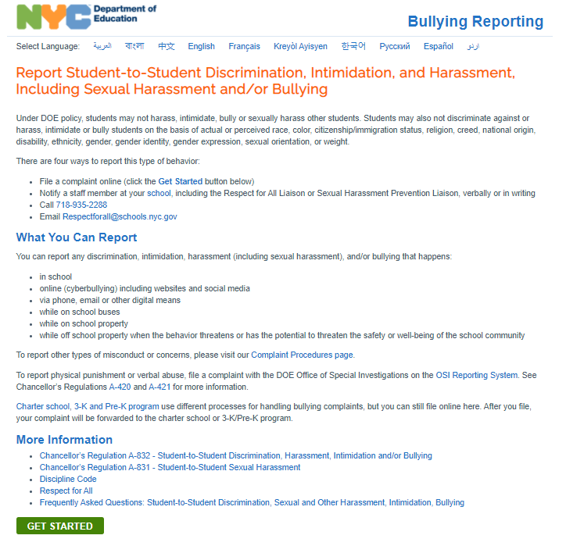
Online Portal
Notes:
https://www.schools.nyc.gov/docs/default-source/default-document-library/student-to-student-discrimination-sexual-and-other-harassment-intimidation-bullying-faq
https://www.schools.nyc.gov/school-life/school-environment/respect-for-all

Slide 25

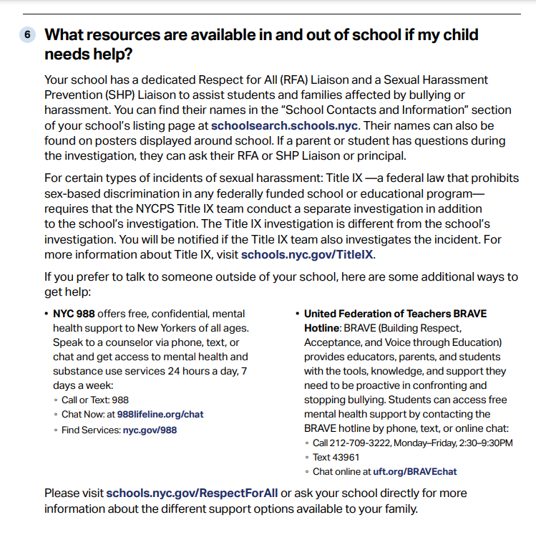
Frequently Asked Questions
Notes:
https://www.schools.nyc.gov/docs/default-source/default-document-library/student-and-parent-complaint-reporting-form
https://www.schools.nyc.gov/school-life/school-environment/respect-for-all

Slide 26
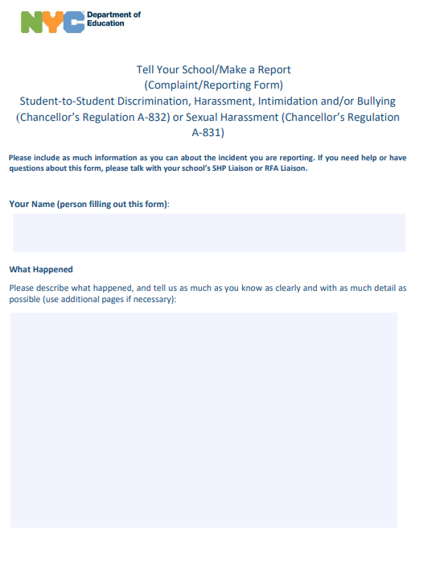
Student and Parent Complaint/Reporting Form
Notes:
In your child’s schools you should see these posters conspicuously posted in locations deemed highly visible to students, parents and staff. The posters must contain the name of the RFA liaison(s) and SHP Liaisons.

Slide 27

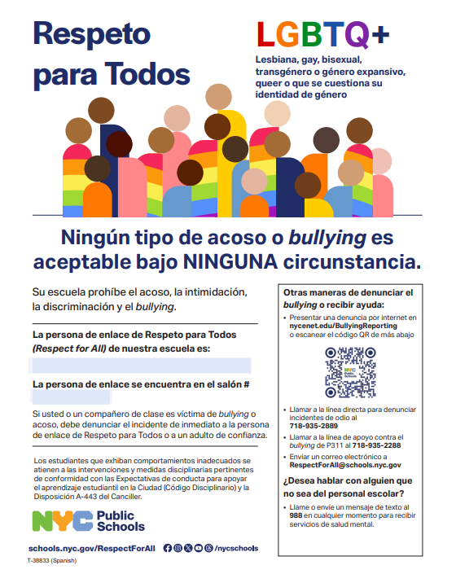
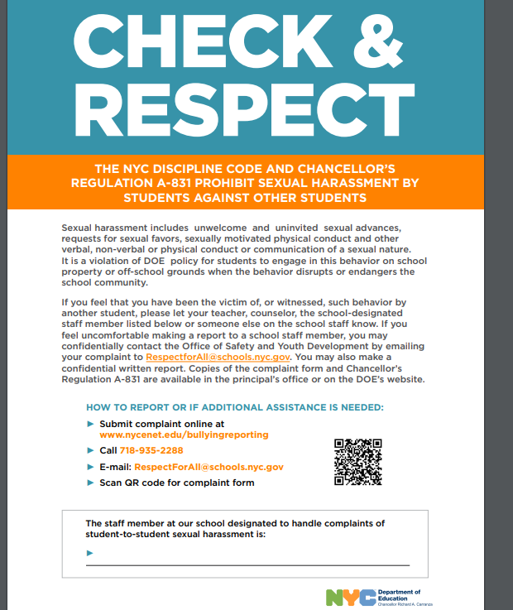
Posters in Schools with Name(s) of Respect for Liaison(s) and Sexual Harassment Prevention Liaison(s)
Notes:
Under Chancellor’s Regulation A-832:
All reports of bullying, harassment, discrimination or intimidating behavior will be investigated.
After a report is made it will be investigated and students who are engaged in forbidden behavior are subject to appropriate intervention and disciplinary action consistent with the Discipline Code.
Schools are not permitted to tell you about the discipline or interventions they are providing to the other student(s) accused of the banned behavior.
Student support if appropriate will be provided and if the behavior constitutes criminal activity, the police will be contacted.
Individual or group counseling, referral to an external agency and/or other interventions will be provided if appropriate.

Slide 28
What happens after a report is made?
The principal/designee must advise the parent(s) of the alleged victim and the accused student of the allegations whenever a report is received. Such notification must be made immediately but no later than two (2) school days following receipt of the report by the principal/designee.
At the conclusion of the investigation, the principal/designee must enter the following information into OORS: the investigative findings; a determination of whether the allegations have been substantiated; and a determination of whether the conduct constitutes a violation of the regulation. This information must be entered into OORS within ten (10) school days of receipt of the report, absent extenuating circumstances.
Notes:
Retaliation against someone who reports an incident is prohibited.

Slide 29
Retaliation
Retaliation against someone who reports an incident of
harassment, bullying, intimidation or discriminatory behavior or
who participates in or helps in an investigation is prohibited.
Students who believe they have been retaliated against should
immediately tell any teacher or other staff member in the
school, or the supports outside the school covered earlier in
this presentation.
Notes:
The DOE respects the privacy of all complaints being made.
Therefore, the parents of the alleged victim may only be notified of any follow-up action, interventions or supports that pertain to the alleged victim and the parents of the accused student may only be notified of any follow-up action, interventions or supports that pertain to the accused student.

Slide 30
Confidentiality
It is the policy of the DOE to respect the privacy of all parties and witnesses to reports made under this regulation. However, the need for confidentiality must be balanced against the obligation to cooperate with police investigations, to provide due process, and/or to take necessary action to investigate or resolve the report, including providing supports and interventions. Therefore, information regarding the report may be disclosed in appropriate circumstances or as required by law or where necessary to protect a student whose safety or well-being is at risk.
The DOE respects the privacy of all complaints being made.
Therefore, the parents of the alleged victim may only be notified of any follow-up action, interventions or supports that pertain to the alleged victim and the parents of the accused student may only be notified of any follow-up action, interventions or supports that pertain to the accused student.
Notes:
If you want to escalate a complaint to the superintendent because
You believe school staff retaliated against you or your child for making a prior complaint at the same school; or
Your child has been the victim of two or more complaints in the same school year or
You did not receive a Notice of Determination, an outcome of a complaint, from the school within 10 school days of the complaint.
The victim, accused, and/or witnesses need additional help accessing supports and interventions regarding an A-831 or A-832 Complaint reported to the school.
You can submit an escalation form, shown on the next slide, or contact the superintendent office for help.

Slide 31
Escalation Assistance from Superintendent and Family Support Coordinator
You believe school staff retaliated against you or your child for making a prior A-831 student-to-student sexual harassment) or A-832 Complaint ( student-to-student discrimination, harassment, intimidation and/or bullying) at the same school; or
Your child has been the victim of two or more A-831 or A-832 Complaints in the same school year that were determined to be material incidents (i.e., violations of Chancellor’s Regulations A-831 or A-832); or
You did not receive a Notice of Determination from the school within 10 school days of the school’s receipt of the open A-831 or A-832 Complaint.
The victim, accused, and/or witnesses need additional help accessing supports and interventions regarding an A-831 or A-832 Complaint reported to the school.
Notes:
You can find this form on the DOE’s website under Respect For All and the list of superintendents for assistance, https://www.schools.nyc.gov/school-life/school-environment/respect-for-all

Slide 32
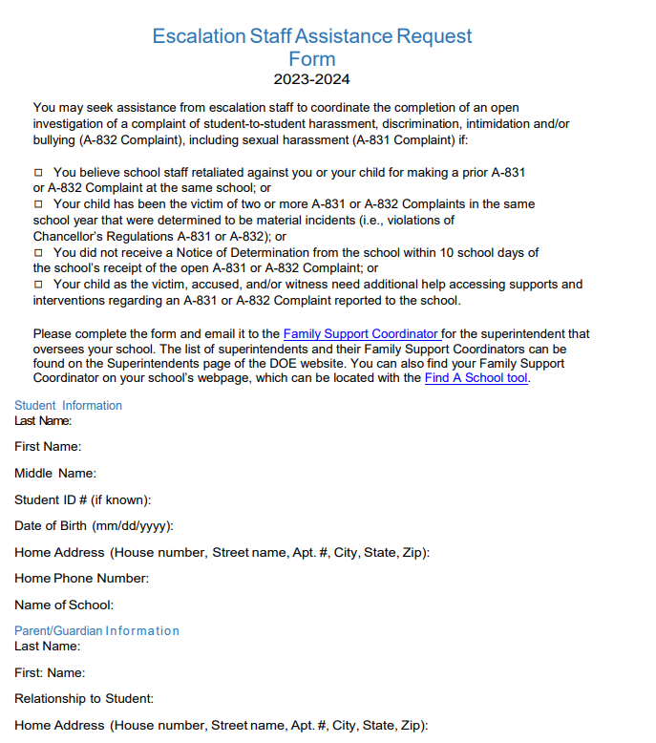
Request for Escalation Staff Assistance Form
The list of superintendents
and their Family Support
Coordinators can be found
on the Superintendents
page of the DOE website.

Slide 33

Part III:
Cyberbullying and Protection
Notes:
In the last part of this presentation, part III, we will discuss cyberbullying and what we can do together to protect our children.
Resources on Internet Acceptable Use Policy ( IAUP), https://www.schools.nyc.gov/about-us/policies/internet-acceptable-use-policy and https://www.schools.nyc.gov/school-life/school-environment/digital-citizenship

Slide 34
What is Cyberbullying?
Discrimination, harassment, intimidation and/or bullying includes electronically transmitted communications and cyberbullying (e.g., via technology including, but not limited to internet; cell phone; email; personal digital assistant; wireless handheld device; social media; blogs; texting; apps; chat rooms; and gaming systems).
Notes:
As parents and educators we have responsibilities to make sure our children and students act responsibly. It’s important to keep track of our children’s online use and to discuss our shared values on how we treat each other.
examples of parent responsibilities:
-lead by example
-cyberbullying is a social emotional issue, not a technology issue

Slide 35

Parent Responsibilities
Make sure your child acts responsibly.
Keep track of your children's online use when they are not in school—including mobile apps, online games, and other social media
Share values with your children and talk with them about what is—and is not—acceptable online behavior.
Notes:
If your child is bullying other children involve your child in making amends or repairing the situation, let them see how their actions affect others. For example, your child can:
Write a letter apologizing to the student who was bullied.
Do a good deed for the person who was bullied or for others in your community.
Speak with their school counselor or administrator.
Work with your child’s school if you think additional referrals or resources are needed.

Slide 36
What You Can Do About Bullying: If Your Child is Bullying
Involve your child in making amends or repairing the situation. The goal is to help them see how their actions affect others.
Your child can benefit from participating in positive activities. Involvement in sports and clubs can enable them to take leadership roles and make friends without feeling the need to bully.
Other times children act out because something else—issues at home, stress—is going on in their lives. They also may have been bullied.
Notes:
Recommend to your children to follow school rules and to :
-remind students they are empowered to address cyberbullying

Slide 37
Student Responsibilities
Follow all school and class rules for using technology
Collaborate in positive ways that help you learn
Use technology to support an inclusive school community
Act responsibly to all—both online and face-to-face
Only use accounts that belong to you
Protect passwords—don’t share them with others
Don’t automatically save passwords on school devices
Don’t give out personal information online without your parent’s permission
Have permission from you before meeting anyone in person that they have met only online

Slide 38
Families, Students, and Social Media
As a suggestion keep computers in shared areas of the household and restrict usage of the Internet to certain hours of the day.
Remember many cell phones have Wi-Fi access – without a data plan students can still get online on their phones.
Create a positive digital image
Post Responsibly
Consider the Consequences
Take Threats of Cyberbullying Seriously
Notes:
To control their own digital images, young people have four basic tools: matching their personal image with their online image, being positive, being the best person they can be, and knowing their audience.
Google yourself, your child, and other friends and family. What are the results? Are you surprised by any posts? Does someone else come up?

Slide 39
Manage Your Online Image
Remind your child that many people are possible audience members online.
What would they like their teacher to see?
How about a middle school/high school or college they want to go to?
What if something they posted became a big news story?
Discuss what they can do to correctly manage their online image.
Notes:
If your child was the subject of a newspaper article, what would they want the headline to read? Write the headline.
Now let’s see what other students produced.
One sentence video hits home the point that if kids concentrate their energy towards achieving goals, bullying/cyberbullying will be mitigated, https://youtu.be/ndqdD6EXat4
They try to answer the questions below with one single sentence. - How do you want to be remembered? - What is your life all about? - How will you look back on your life? - What do you want to accomplish?

Slide 40
Headline Exercise
You can also watch the "One Sentence Project" video(Open external link) to hear how other students have answered the below questions.
If you were the subject of a newspaper article, what would the headline read?
How do you want to be remembered?
What is your life all about?
How will you look back on your life?
What do you want to accomplish?
Notes:
Once your child is old enough to create an account (typically, 13), you should set up social media accounts and review the privacy settings together. Make sure your child is only having online friendships and conversations with people you approve of. Pay attention to where your child goes online. You may want to think about using parental controls or safe searching on certain sites. Also, speak to your child about what they should do if they find a bad site.
Events in the news and with friends and family offer great ways to talk about responsible posting. When stories happen, talk with your child about how they would respond to it. Don’t focus only on what not to do. It’s also important to talk about ways people use social media for good.

Slide 41
Post Responsibly
As a parent, you play a key role in ensuring your child is posting correctly and protecting their personal info online.
You can help your child post in ways that best show the values of your family.
Talk with your child about sites or searches that you believe are unsafe or risky.
Notes:
Explain to your child why it’s unsafe to post your address, birth date, or other personal information and what identity theft means. Use real examples if you can find them.
As mentioned before, talk to your child about not sharing passwords with friends and make sure you both know how to prevent computers you share with others from automatically saving passwords. (For example, always log off when you have finished using a site – don’t just close the browser). Let your children know that they can be held responsible for another person’s actions when that person uses their online accounts to post information or buys something.
Schools should notify parents each year about school or classroom-based social media activities. If you haven’t heard anything, talk to your child’s teacher, and your child.
Find out about what kinds of social media activity, if any, is part of their classroom work. Talk about the school’s use of social media with your child the same way you would talk about other school work.

Slide 42
Consider the Consequences of Your Online Actions
It’s important for students to think through the effects of their online behavior.
They also must be careful about both the websites they visit and who they are talking with online.
Students don’t always realize that what they do outside of school can have effects at school. This is especially true online.
Notes:
Be aware of your child’s behavior online.
You may want to “friend” or “follow” your child.
Some families keep a copy of their child’s online usernames and passwords; others have a place where all family passwords are kept in case of emergency.

Slide 43
Be Aware of Your Child’s Behavior Online
Set rules for what behavior is allowed online for your family and talk about the Student Social Media Guidelines at home found on the DOE’s website, Digital Citizenship
You may also want to buy filtering software or set up a program to track computer and cell phone use.
Notes:
Talk about examples and why cyberbullying could hurt someone’s feelings or make someone upset.
Some signs of cyberbullying (both being bullied, and bullying) are: removing themselves from daily activities, getting upset when online or texting, quickly closing out of sites when an adult walks by, or avoiding questions about what she is doing on the computer.
Discuss strategies to give students ideas about what to do when someone they know is being targeted, or if they are being targeted themselves.
If you suspect your child is bullying someone, it’s important to know about the situation. Try to find out the reasons and come up with a plan to deal with and correct the behavior with your child. Your child’s school Respect for All liaison or guidance counselor can help you with this.

Slide 44
Take Threats of Cyberbullying Seriously
Cyberbullying is the use of electronic technologies to hurt or harass others.
Examples include creating or forwarding mean or hurtful text messages or emails, posts that are not true and create rumors, and embarrassing photos.
Notes:
Talk about examples and why cyberbullying could hurt someone’s feelings or make someone upset.
Some signs of cyberbullying (both being bullied, and bullying) are: removing themselves from daily activities, getting upset when online or texting, quickly closing out of sites when an adult walks by, or avoiding questions about what she is doing on the computer.

Slide 45
Role Play Being an Ally
When your child sees that someone they knows is not being treated with respect, encourage them to support the victim.
Try to find real examples of this from your life or in the media.
Talk with your child about the different ways they might respond.
Next do a role play to act out how this might work.
Notes:
Role play with your children to practice what to do if they see bullying or are being bullied. They can do that by privately telling the victim that they are sorry for what the victim is going through or by speaking up publicly.

Slide 46
I-Messages- Role Playing is Key
I feel _________________________________________________
(State the feeling- be as specific as possible)
When you _____________________________________________
(Describe the specific behavior)
Because ______________________________________________
(Describe the impact the behavior has on you)
And I would appreciate it if you would (or And I want you to...) ____________________
(state what action on the part of the other person would make the situation better for you)
Notes:
Practice through Role Plays: What I-Messages could you use in this situation? Discuss: How does it feel to give assertive messages? Emphasize that rehearsing ways to respond to bullying, and practicing the actual words we might use out loud, can help us to feel more confident and prepared when real-life situations arise.

Slide 47
Reflecting Activity
Think about on what we shared and discussed today and visualize how we can
continue working together in supporting our children whether at home or in our school
community.
What does it look like?
What does it feel like?
Notes:
Let’s reflect on what we did today.

Slide 48
Resources
Chancellor’s Regulation A-831
Chancellor’s Regulation A-832
Discipline Code
Respect for All: Preventing and Addressing Student-to-Student Discrimination, Sexual and Other Harassment, Intimidation, and Bullying
Internet Acceptable Use Policy
Digital Citizenship
Ways to Support Your Child During Remote Learning
Parents' Ultimate Guide to Parental Controls

Slide 49
Role Play Being an Ally
When your child sees that someone they knows is not being treated with respect, encourage them to support the victim.
Try to find real examples of this from your life or in the media.
Talk with your child about the different ways they might respond.
Next do a role play to act out how this might work.

Slide 50
Thank you
I've learned that people will forget what you said, people will forget what you did, but people will never forget how you made them feel.
-Maya Angelou
For Questions: Please email RespectForAll@schools.nyc.gov
Notes:
Thank you and we will close with a quote by author Maya Angelou.
Please feel free to contact Respect For All for assistance, email us at Respectforall@schools.nyc.gov, thank you.

