Slide 1


Frequently Asked Questions for CR A-831 and CR A-832 Complaints
for Parents and Guardians
Office of Safety and Youth Development
Respect for All is our system-wide response to bullying and harassment. We are committed to keeping our schools safe, supportive, and free from discrimination.

Slide 2

How can I report bullying and/or sexual harassment?
It is important to tell your school so that they can take the right steps to make sure that the behavior stops, and you/your child gets support.
You can report an incident involving yourself, your child, or another student who is being bullied or harassed by:
telling any teacher or other staff member in your school
filling out this form and giving it to any staff member in your school
filing a complaint on the DOE’s online portal: https://www.nycenet.edu/bullyingreporting
After reporting, parents may ask the school administration for the incident number, also known as the Online Occurrence Reporting System (OORS) number.

Slide 3
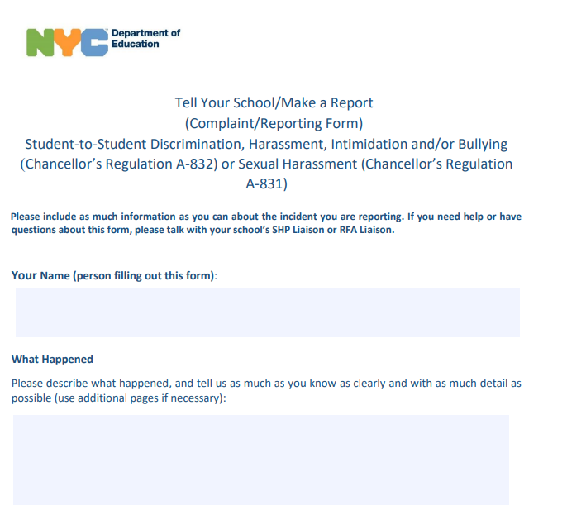
Student and Parent Complaint Reporting Form
You can submit a handwritten report of sexual harassment or bullying complaints by turning the form in to your school
Additional languages can be found at: www.schools.nyc.gov/school-life/school-environment/respect-for-all

Slide 4
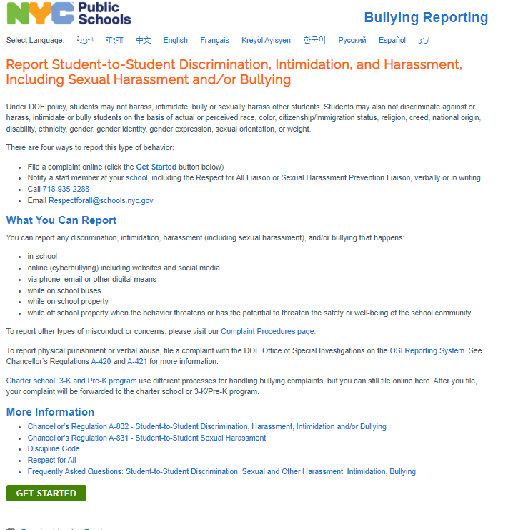
Bullying Online Portal
Under DOE policy, students may not harass, intimidate, bully or sexually harass other students. Students may also not discriminate against or harass, intimidate or bully students on the basis of actual or perceived race, color,citizenship/immigration status, religion, creed, national origin, disability, ethnicity, gender, gender identity, gender expression, sexual orientation, or weight.
Additional languages can be found directly on the top of the form

Slide 5
How can I learn about the DOE’s policies and procedures and ways to get help?
The Respect for All (RFA) Liaison at your school
The Sexual Harassment Prevention (SHP) Liaison at your school -The RFA and SHP Liaisons are trained to help students and parents, and to work with your school to prevent bullying and sexual harassment.
If you prefer to talk to someone in the DOE outside of your school, here are some additional ways to get help:
Contact Respect For All by calling 718-935-2288, or
Emailing RespectForAll@schools.nyc.gov
If your concerns involve sexual or gender-based harassment, email the DOE’s Title IX Coordinator at Title_IX_Inquiries@schools.nyc.gov .
Please visit www.schools.nyc.gov/school-life/school-environment/respect-for-all for more information.

Slide 6

If you don’t know who these Liaisons are at your school:
If you don’t know who these Liaisons are at your school:
Ask a staff member or any teacher in your school
Go to www.schools.nyc.gov , search for your school, and find your Liaisons listed under “School Contacts and Information.”
Find their names on the Respect for All and the Check & Respect posters in your school.

Slide 7
What supports can your school provide if you/your child feels unsafe or needs support
As soon as possible, let a staff member at your school know. Your school will work with you to provide supports to make you/your child feel safe.
You can request supports at any time, including before, during, or after the school investigates a complaint.
Your school can connect you/your child with a school counselor, social worker, psychologist, or a mental health professional in the community.
Your school can also explore with you academic supports and adjustments like a change in classes, lunch/recess, or after-school program schedules.
The school might also work with you/your child to build an individual support plan to meet your/your child’s specific needs. The plan will explain the supports being provided during the school day and DOE programs/activities. This may include regular check-ins with staff and specific school staff to provide support for a certain period of time to make sure the behavior stops.
If your child has a disability and you are concerned that an incident is affecting their learning, speak with your/your child’s IEP team, Section 504 Team, and school administrator
If a parent or student has questions during the investigation, they can ask the RFA or SHP Liaison or principal.

Slide 8
How are complaints investigated?
A staff member at your school will investigate the complaint by taking the following steps:
Talking separately to the students involved in the incident
Asking them questions about what happened, if there are any students who have information about the incident or any evidence (like video, text messages, posting on social media)
Asking them to prepare a written statement
Talking separately to others who might have seen what happened, know something about what happened, or have any evidence and asking them to prepare a written statement.

Slide 9
How will I be notified of the school’s decision after the investigation?
The school will consider all of the information it received during the investigation and make a decision about what happened and how to support you/your child.
The school will give a letter to the parents of the students who were involved notifying them of this decision within 10 school days after a report is made. Sometimes the school may need more time to investigate.
Supports are available at your school and you should contact the school to discuss them.
Parents of the students involved in an incident will be given information about their own child. The school will not tell parents about supports or discipline for another student.

Slide 10
How can I get assistance if I need more help than what the school is providing?
If you need more assistance than what your school is providing, you can do any of the following:
Submit a complaint requesting additional help
Talk to a staff member at the school who you feel comfortable with
Contact Respect For All by calling 718-935-2288, or emailing RespectforAll@schools.nyc.gov
Complete the Escalation Staff Assistance Request Form and email it to the Family Support Coordinator for the superintendent that oversees your school
Contact the Family Support Coordinator at the superintendent’s office

Slide 11
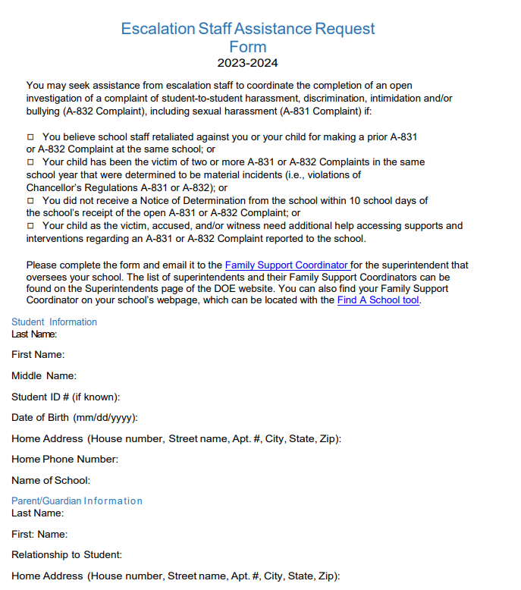
Request for Escalation Assistance Form
Please complete the form and email it to the
Family Support Coordinator for the
superintendent that oversees your school. The
list of superintendents and their Family
Support Coordinators can be found on
the Superintendents page of the DOE website.

Slide 12
Is a complaint confidential?
Your school knows your report is sensitive, and will make every effort to:
keep reports confidential as much as possible
share information only when needed to investigate or keep students safe
Parents are told about incidents involving their child. Students should talk to their schools if they have concerns about notifying their parent. Schools can help work with the student and parent and provide support.
If the report involves a crime, the school must notify the NYPD.

Slide 13
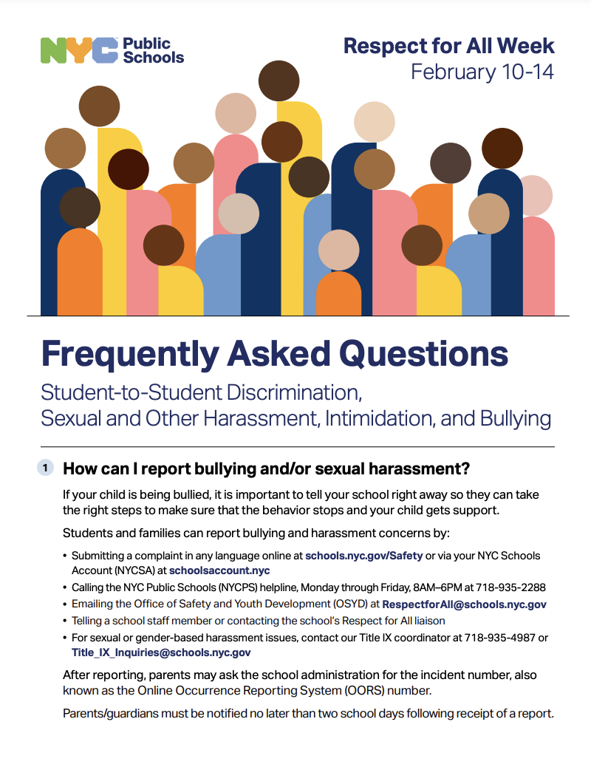
Student-to-Student Discrimination, Sexual and Other Harassment, Intimidation, Bullying FAQ
This Frequently Asked Questions and Respect for All Flyer are resources for students and parents about how to report incidents, the investigation process, and supports and interventions to prevent and address student-to-student sexual harassment and student-to-student gender-based harassment, bullying, intimidation, and/or discrimination.
Additional languages can be found at: www.schools.nyc.gov/school-life/school-environment/respect-for-all

Slide 14
Additional Resources and Questions
Chancellor’s Regulations:
A-831
A-832
Discipline Code:
K-5
6-12
Contact by emailing RespectForAll@schools.nyc.gov

