Slide 1
Highlights from the 2025 NYC School Survey:
Results
[Insert School Name Here]
Insert Your School’s Picture Here

Slide 2
Agenda
NYC School Survey Overview
Who did we hear from?
What are we proud of?
Where do we see opportunities to improve?
How are results used?
How can you review results?
Next steps!
Notes:
Instructions
Format your presentation slides to your audience. This slide deck can be presented at a Parent-Teacher conference, PA or PTA meetings, etc.

Slide 3
Instructions for Use (internal only)
Now that the 2025 NYC Survey results are available to the public, the purpose of this deck is to share your results with your families.
Slides that require you to fill in your school’s information have instructions included in the notes section. Update the points in gray with information specific to your school.
Remove this slide when ready to share.
Notes:
Instructions
This is the notes section where you will find instructions for each slide.

Slide 4




NYC School Survey Overview
Each year, all families, teachers, and students in grades 6-12 take the NYC School Survey.
The survey is aligned to the newly redesigned School Quality Reports which aims to be intuitive and aligned with New York City Public Schools' priorities.
We use feedback from the survey to reflect and improve our school.
Results from the survey are available on the Panorama Education website.
Notes:
Instructions
Use this slide to explain the purpose of the annual NYC school survey.

Slide 5
Who did we hear from?
​ | 2024 Response Rate | 2025 Response Rate
Students​ | XX​ | XX
Families | XX | XX
Teachers​ | XX | XX​
Internal only – TIP! If your school was awarded the 2025 NYC School Survey Response Rate Recognition Award, be sure to let families know! If you do not serve students in grades 6-12, feel free to write N/A or delete the row.
Notes:
Instructions:
Update the response rate numbers from 2023 and 2024 by looking at your school’s reports on Panorama Education's website.

Slide 6
What are we proud of?
XX students agreed or strongly agreed that their classes at their school really make them think critically.
XX parents/guardians agreed or strongly agreed that the principal/school leader at their schoolwork hard to build trusting relationships with parents/guardians like them.
Notes:
Instructions:
Review your results from the 2024 NYC School Survey and make note of the results that stand out to you as a school leader.
Update the examples with your information. Think about what results you are proud of and include screenshots of results from your online school report that you want to highlight on this slide.

Slide 7
Where do we see opportunities to improve?
XX students agreed or strongly agreed that their classes at their school really make them think critically.
XX parents/guardians agreed or strongly agreed that the principal/school leader at their school works hard to build trusting relationships with parents/guardians like them.
Notes:
Instructions:
Review your results from the 2024 NYC School Survey and make note of the areas you identified for continued improvement.
Think about what factors of school life could be contributing to the results you see and what areas you want to focus on. Consider including screenshots of results from your online school report that you want to focus on and update the above examples with your information.

Slide 8
How Did We Use Results to Improve Our School?
Upon learning XX of students are satisfied with our school's meal options, we conducted listening sessions and will now serve more culturally appropriate foods.
Upon learning XX of parents know how to contact our Parent Coordinator, we're hosting a family breakfast and adding their contact QR code in our lobby.
Notes:
Instructions:
Review your results from the 2024 NYC School Survey and make note of the areas you identified for continued improvement.
Think about what factors of school life could be contributing to the results you see and what areas you want to focus on. Consider including screenshots of results from your online school report that you want to focus on and update the above examples with your information.

Slide 9
How is the Survey Data Used at the Citywide Level?
Results inform professional development and outreach. For example, schools scoring low on Preventing Bullying may be recruited for Bullying Prevention Trainings.
Survey results are included in the School Quality Snapshot, which compiles various school-level data into a clear report aimed to help students, families, and other members of the community evaluate and choose schools that will be a best fit.
Survey results appear in the Mayor's Management Report. This report, required by City law, shows how well city agencies are serving the public.
Results inform citywide program evaluations and research, ensuring initiatives deliver the high-quality supports and services students deserve.
Notes:
Instructions
Use this slide to explain the purpose of the annual NYC school survey.

Slide 10
Families Can Access Citywide NYC School Survey Results!
Learn about what other families' think about your school community
Teachers' and staff's opinions about your school
What students (grades 6-12) think about their experience
Compare results with other schools in your area
Over the next few slides, we will share how to access results on the Panorama Platform!
Notes:
Instructions:
Review your results from the 2024 NYC School Survey and make note of the areas you identified for continued improvement.
Think about what factors of school life could be contributing to the results you see and what areas you want to focus on. Consider including screenshots of results from your online school report that you want to focus on and update the above examples with your information.

Slide 11
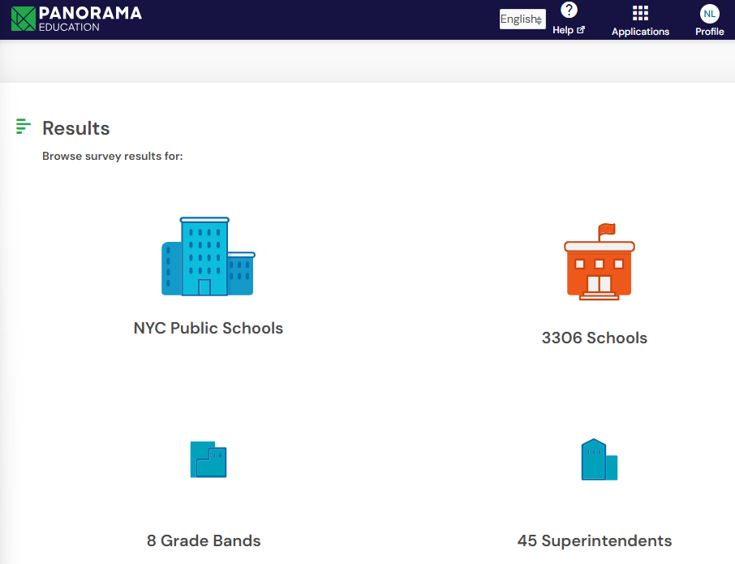
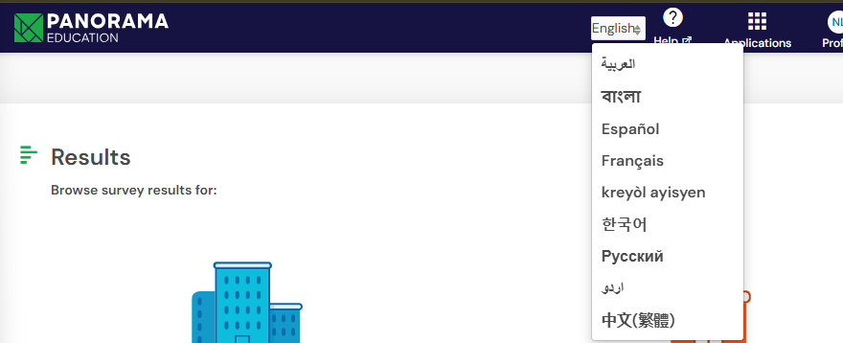
Accessing Results
Use this link: https://secure.panoramaed.com/nycdoe/understand?auth_token=NeMqBRG7xyKtyeqmK_Nd
Once you reach the Panorama Platform homepage, click the Schools icon, and type in your school's name!
The Panorama Platform can be translated into the 9 official NYCPS supported languages

Slide 12
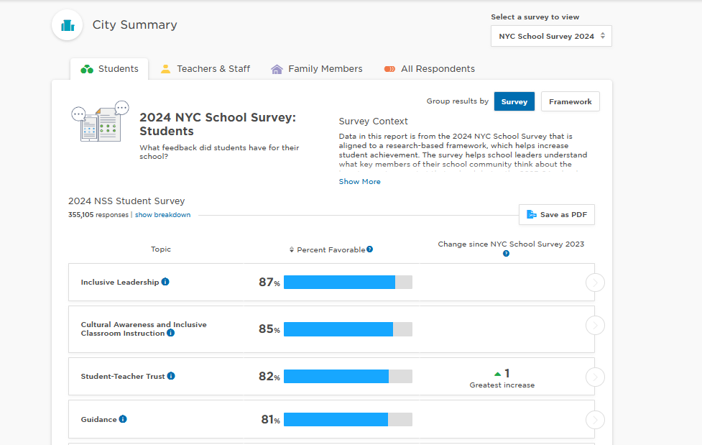
Once you access your school's report, click "Family Members" to access Family Results
Once you are in the family members page, you can see your school's survey results broken down by measure. You can click each measure to see the questions included in the measure.
Please remember to consider your school's family response rates when reviewing your results.
You can also click the dropdown "select a survey to view" to review data from previous years. NSS results from 2021-2025 are available on the platform!
12

Slide 13
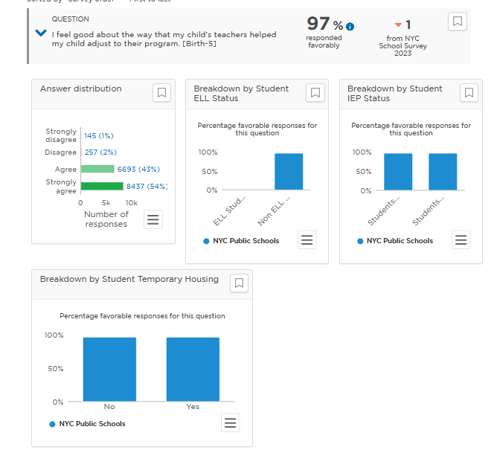
Explore Your School's Responses by Demographic
Your school's results will be disaggregated by demographic. This provides you with the opportunity to better understand how, if at all, families may respond differently based on their background.
The platform groups family's responses by:
  Demographic (race/ethnicity)
  Gender of student
  Grade of student
  Students' IEP Status
  ELL Status
  STH Status
13

Slide 14
Have Questions or Feedback on Using the Platform?
Contact [NAME] at [EMAIL/NUMBER] at our school
The NYCPS Survey Initiatives team is also available to help with platform questions or to discuss your school's results - email them at Surveys@schools.nyc.gov.
Notes:
Instructions:
Review your results from the 2024 NYC School Survey and make note of the areas you identified for continued improvement.
Think about what factors of school life could be contributing to the results you see and what areas you want to focus on. Consider including screenshots of results from your online school report that you want to focus on and update the above examples with your information.

Slide 15
Next Steps
Find NYC School Survey results at here.
How would you like us to implement feedback from the 2025 survey? Your insights help create meaningful improvements for our school.
Remember, the survey returns each spring - your voice matters every year!
Notes:
Instructions
On this slide, outline what your school or program has learned from previous survey administrations. What did you learn and how did you put it into practice? How will the survey results impact your school's plan moving forward?

